Slide 1
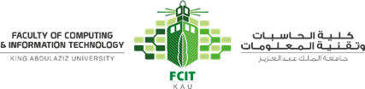
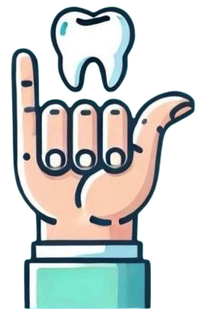
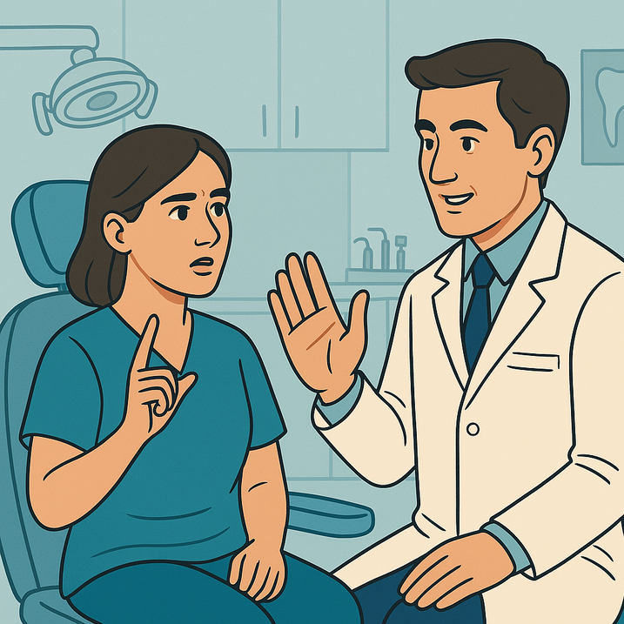
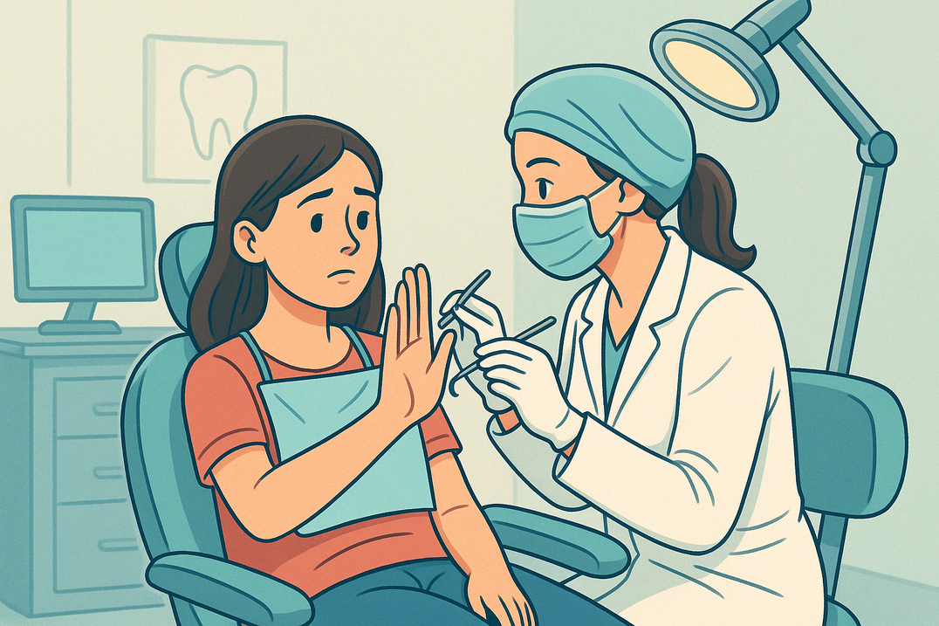
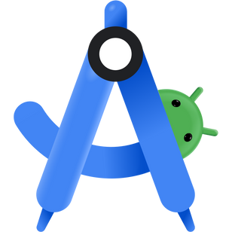
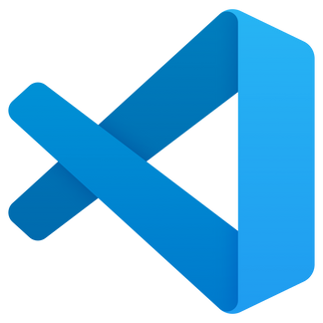
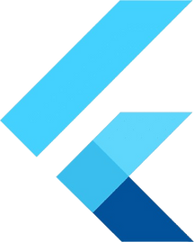
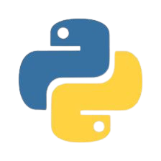
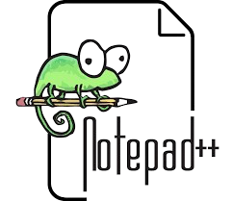
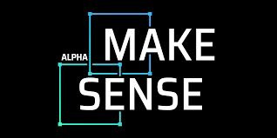
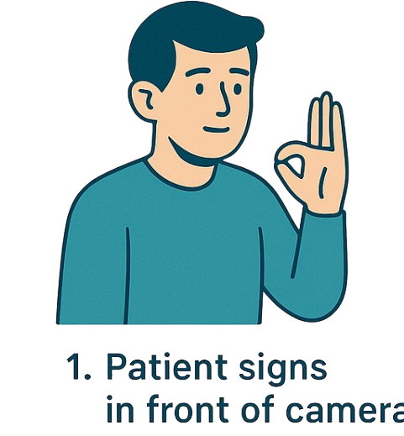
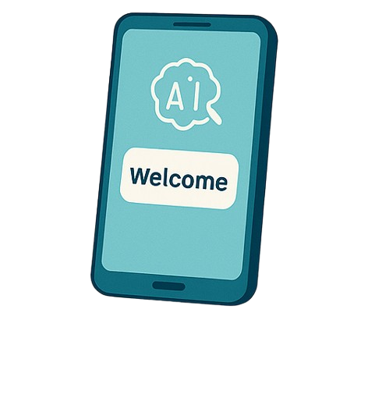
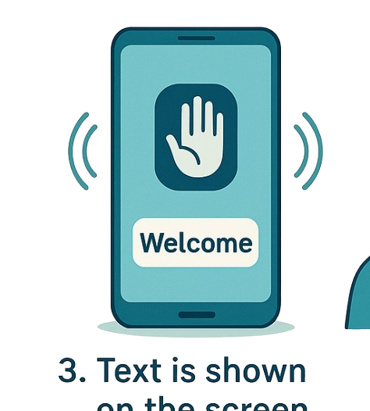
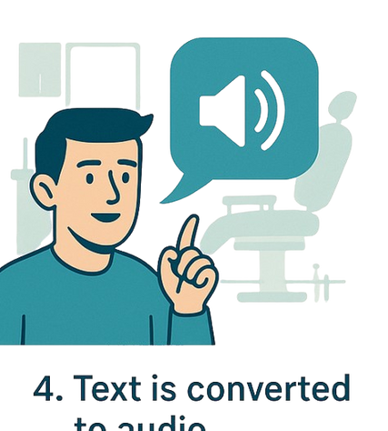
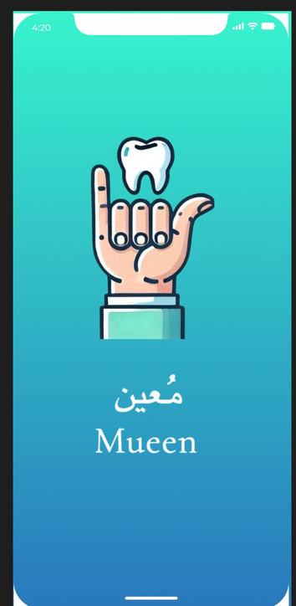
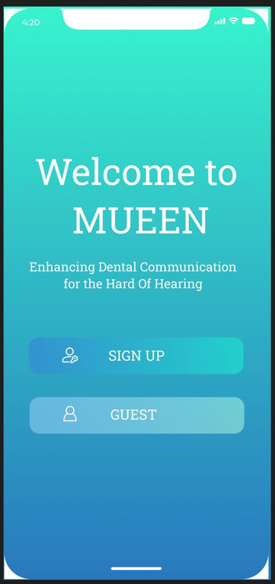
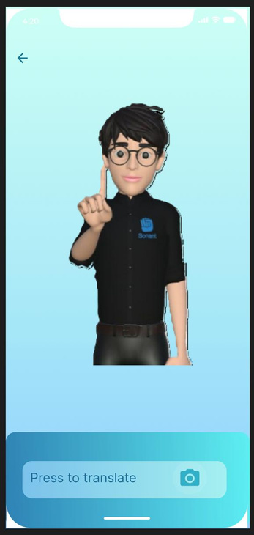
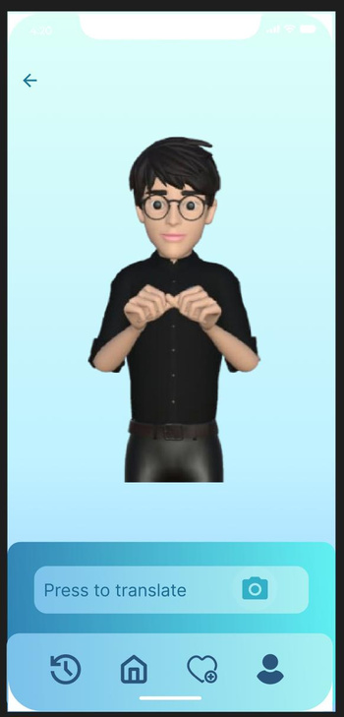
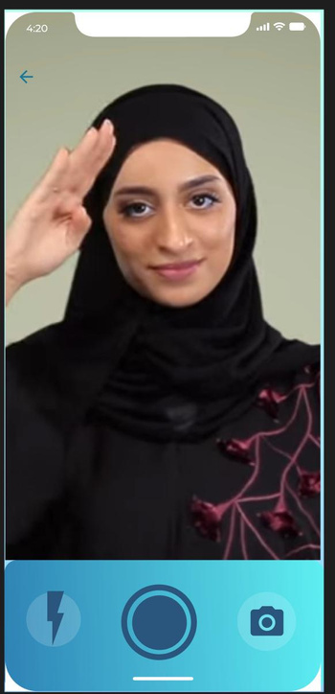
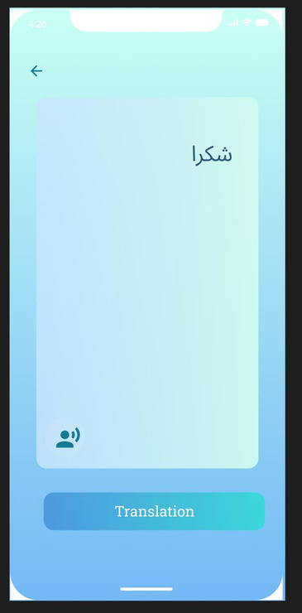
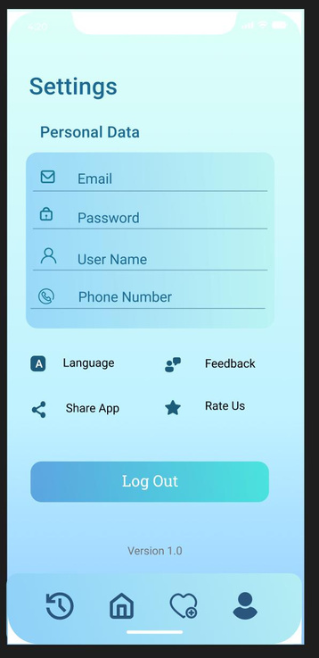
MUEEN | معين
Saudi Sign Language Translator
By: Hadeel Bakhshwen , Jude Kawther , Almaha Abdulwahab , Shahad Alharthi
Supervised : Dr.Anod Alhazmi
Department of Information Technology Faculty of Computing and Information Technology King Abdulaziz University
Introduction
Abstract
Deaf and hard-of-hearing individuals face major communication barriers in dental clinics, often leading to discomfort, miscommunication, or reliance on interpreters. Mueen bridges this gap by translating Saudi Sign Language (SSL) into text and audio, creating a more inclusive, independent, and accessible dental experience.
Mueen is a smart mobile app designed to make communication easier between deaf patients and dental staff. It translates Saudi Sign Language into spoken and written language—using real-time gesture recognition powered by AI. Mueen reduces the need for interpreters and creates a more comfortable, equal, and inclusive experience inside dental clinics.
Challenges
Tools
Absence of Saudi Sign Language datasets — all gesture data was manually collected and labeled for training.
Ensuring accurate gesture recognition in varying dental clinic environments.
Real-time processing — ensuring fast and accurate translations without lag remains a technical challenge.
User interface design — creating a simple, accessible experience for both patients and dental professionals.
Methodology
Results
The user performs a SSL gesture in front of the device’s camera
2. The gesture is analyzed using a trained AI model to recognize its meaning
3.Translated gesture appears as text
4. Text is converted into speech
Acknowledgment
Future Work
In a journey where support was hard to find, your help meant everything. We extend our heartfelt thanks to Mr. Ibrahim Alabdullatif and Dr. Mohammad AlTokais for providing the sign language gestures that brought Mueen to life. When most turned away, you stepped in — and because of you, this project became possible. We’ll always be grateful.
We plan to expand Mueen’s support beyond dental clinics to include other healthcare environments such as hospitals, emergency rooms, and pharmacies. In the long term, our goal is to build a complete system that translates Saudi Sign Language across a wide range of everyday interactions.

